Slide 1
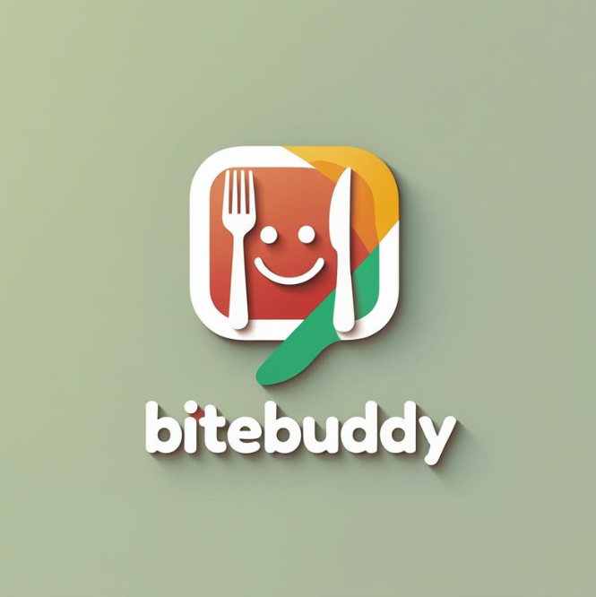

Team 7
BiteBuddy
Where should we eat?
Notes:
Abdala: Intro

Slide 2
Team Roles
Front-end
Back-end
Jonathan Lee
Billy Nguyen
Neon Zheng
Abdala Aljiewarane
Rafid Nasery
Paola Isabel Reyes-Almendares
Notes:
Neon: Team Roles

Slide 3
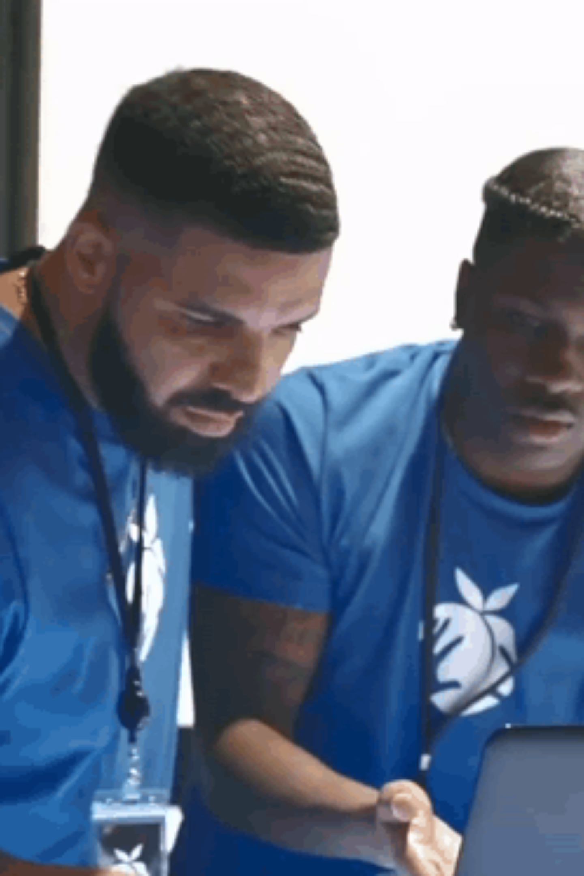
Overview
Problem:
Solution:
Friends often struggle to agree on where to eat together: indecisiveness, mismatch preferences and dietary restrictions can over complicate discussions.
A swipe-based app that pairs friends, pulls nearby restaurants matching both users' preferences, and finds a match when both swipe right on one.
Notes:
Abdala: Problem
Jonathan: Solution

Slide 4
Tech Stack
Frontend: React Native
Backend: NextJS
Database: Supabase (Postgres + RealTime)
Auth: Supabase Auth
APIs: Yelp Fusion API (restaurant search)
Deployment: Vercel (Web+API), Expo EAS (Mobile)
Notes:
Rafid: Tech Stack

Slide 5
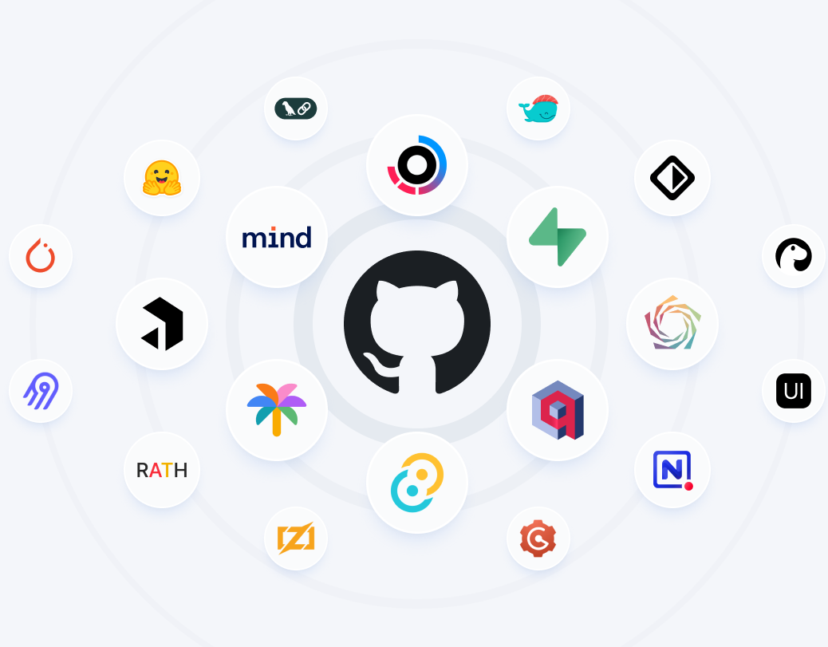
Project Management Tools
We'll be using Github Projects to:
Create decoupled tasks
Assign work
Manage priorities
Notes:
Paola: Project Management Tools

